Slide 1
Principles of Drug Discovery
Lecture 7: ADMET
Notes:
7/3/17
1
1

Slide 2
Absorption
Distribution
Metabolism
Excretion
Toxicity

Slide 3
Bioavailability
35 mg
10
Hepatic Portal Vein
AUC_{IV}
AUC_{oral}
F_{h} = 0.5
8
Liver
6
Drug concentration (mg/L)
70 mg
4
Small Intestines
2
100 mg
F_{g} = 0.7
%F = F_{g} * F_{h} = 0.35
0
0
2
4
6
8
10
12
Time (hours)
Bioavailability is defined as the ratio of the area under concentration-time (AUC) profile of an oral dose and the area under concentration-time profile of the same intravenous dose. AUC has the unit concentration * time.

Slide 4
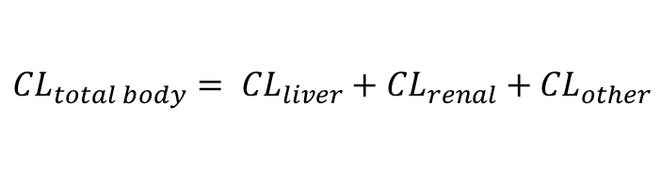
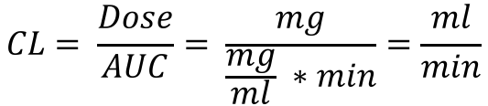
Clearance
Clearance (CL) is the volume of blood cleared of compound per unit time. CL units are volume/time (mL/min). CLs by various organs are additive. The total body clearance of a compound is a summation of the CL contributions by various organs.
Dose Administration
$${CL}_{total body}= {CL}_{liver}+{CL}_{renal}+{CL}_{other}$$
Tissue, Organs, Bodily Fluid
It is related to the AUC as
Metabolism, Excretion
$$CL= \frac{Dose}{AUC}= \frac{mg}{\frac{mg}{ml} ∗min}=\frac{ml}{min}$$

Slide 5
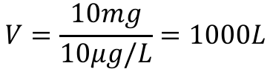
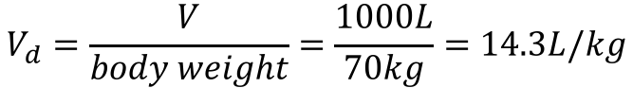
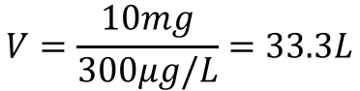
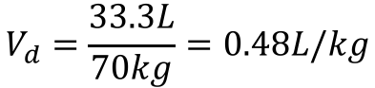
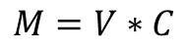
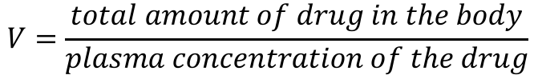
Volume of Distribution
10 mg
The volume of distribution is a measure for the distribution of a molecule into the different parts (tissues) of the body.
$$V=\frac{total amount of drug in the body}{plasma concentration of the drug}$$
? mg/L
It is a proportionality factor between the administered dose and the concentration of drug measured in plasma.
$$V=\frac{10mg}{10μg/L}=1000L$$
$$V_{d}=\frac{V}{body weight}=\frac{1000L}{70kg}=14.3L/kg$$
$$M=V∗C$$
$$V=\frac{10mg}{300μg/L}=33.3L$$
$$V_{d}=\frac{33.3L}{70kg}=0.48L/kg$$

Slide 6
Volume of Distribution
Compounds with a low volume of distribution are primarily confined to the plasma. This is the case for compounds which are
hydrophilic
or highly bound to plasma proteins
Warfarin, Anti-coagulant, Vd = 0.14 L/kg,
PPB > 99%
Rivaroxaban, Anti-coagulant, Vd = 0.62 L/kg

Slide 7
Volume of Distribution
A high volume of distribution indicates rapid absorption into tissue and localization of the drug in cell membranes and fatty tissues
Entrance into the binding site
Lipid bilayer
Felodipine, Calcium-channel blocker, Vd = 10L/kg
L-Type Calcium channel
High or low volumes of distribution or neither good nor bad. But it is an important optimization parameter which requires knowledge of the location of the target.

Slide 8
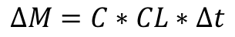
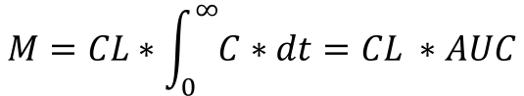
If elimination follows 1. order kinetics, the change of total drug in the body is proportional to clearance and concentration.
10
$$∆M=C∗CL∗∆t$$
8
The total amount of drug therefore writes as
6
Drug concentration (mg/L)
4
$$M=CL∗\int_{0}^{∞}{C∗dt}=CL ∗AUC$$
2
0
0
2
4
6
8
10
12
Time (hours)

Slide 9
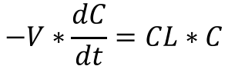
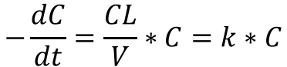
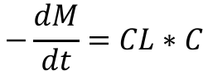
Half-life
Assuming first order kinetics the change in the amount of drug in the body is equal to the product of drug concentration and clearance
$$−\frac{dM}{dt}=CL∗C$$
Rewriting this equation with the relation of for the volume of distribution, concentration and amount of drug:
$$M=V∗C$$
yields
$$−V∗\frac{dC}{dt}=CL∗C$$
Rearranging and substituting CL/V with k results in
$$−\frac{dC}{dt}=\frac{CL}{V}∗C=k∗C$$

Slide 10
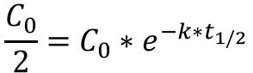
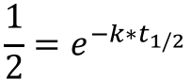
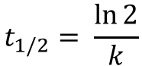
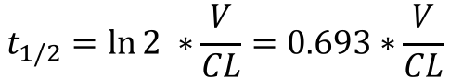
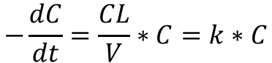
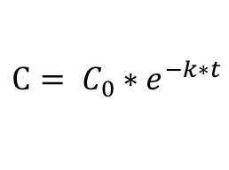
Half-life
Integration of
$$−\frac{dC}{dt}=\frac{CL}{V}∗C=k∗C$$
yields
$$C= C_{0}∗e^{−k∗t}$$
The time at which the concentration reaches half of its initial value can be calculated by substituting C with C₀/2.
$$\frac{C_{0}}{2}=C_{0}∗e^{−k∗t_{1/2}}$$
From which follows
$$\frac{1}{2}=e^{−k∗t_{1/2}}$$
and
$$t_{1/2}= \frac{\ln{2}}{k}$$
Replacing k again with CL/V yields the final relation of the half life to the volume of distribution and clearance.
$$t_{1/2}=\ln{2 ∗\frac{V}{CL}=0.693∗\frac{V}{CL}}$$

Slide 11
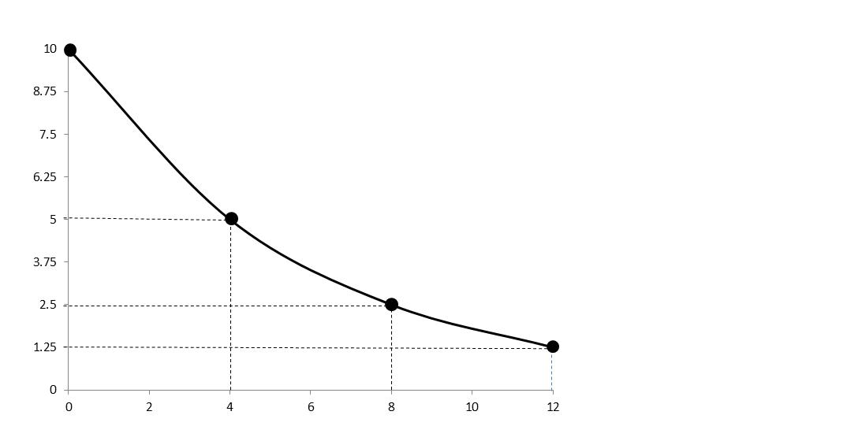
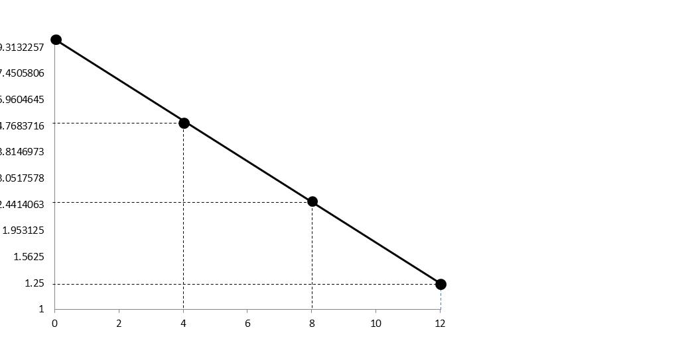
Half-life
10.0
10.0
t_{1/2} = 0.693/k
t_{1/2} = 0.693*(V_{d}/Cl)
5.0
t_{1/2}
t_{1/2}
Drug concentration (mg/L)
5.0
Drug concentration (mg/L)
2.5
t_{1/2}
2.5
t_{1/2}
1.25
t_{1/2}
t_{1/2}
1.25
0
2
4
6
8
10
12
0
2
4
6
8
10
12
Time (hours)
Time (hours)

Slide 12
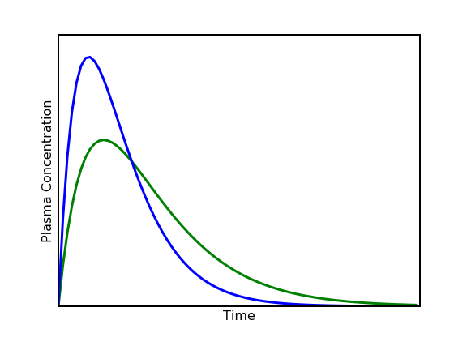
PK Profile
Clearance and volume of distribution shape the pharmacokinetic profile of a compound.
Assuming the same dose and clearance, compounds with lower volume of distribution reach higher C_{max} values but plasma concentration declines faster.
Low Vd
High Vd

Slide 13
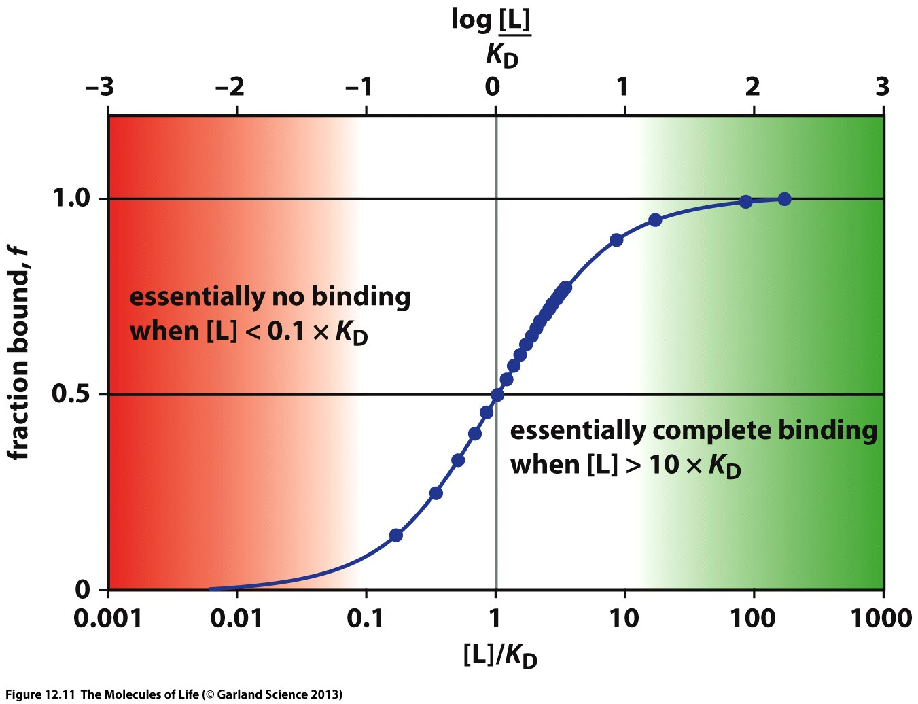
Dosing Interval
Half-life, clearance and volume of distribution determine the dosing interval
10
8
6
Drug concentration (mg/L)
4
2
0
0
2
4
6
8
10
12
Time (hours)
No pharmacological effect anymore

Slide 14
Dosing Interval
In most cases, a PK profile is desirable at which a therapeutic effective concentration can be maintained with a once daily dose of the compound.

Slide 15
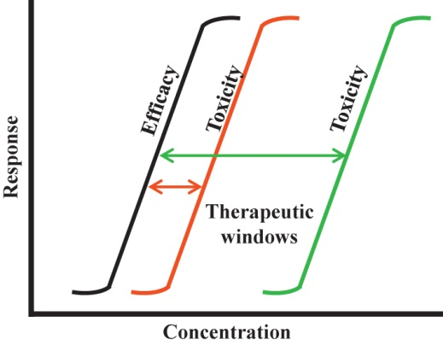
Sola dosis facit venenum (The dose makes the poison)
Every substance becomes toxic at high doses, even substances we do not regard as dangerous
salt
oxygen
pure water
The difference in plasma concentration between a therapeutically effective concentration and a toxic concentration is called therapeutic window.

Slide 16
Safety
Safety is the second major cause why new drug candidates fail in clinical trials.
Toxicity can be separated in two categories:
Target-related toxicity:
Pharmacologic modulation of the target leads to undesired (toxic) effects
Off-target toxicity:
The compound hits other than the intended target which leads to toxicity.
Many anti-cancer drugs which interfere with cell division

Slide 17
Vioxx®(Rofecoxib)
Riluzole
Increased risk for myocardial infarction by a factor of 4
Increased risk of hart attacks by a factor of 4
Approved for the treatment of amyotrophic lateral sclerosis, which has a 80% 5-year mortality rate.
Pain medication which has been removed from the market.
Safety is a very complex topic which has to be balanced with the severity of disease and alternative treatment options.

Slide 18
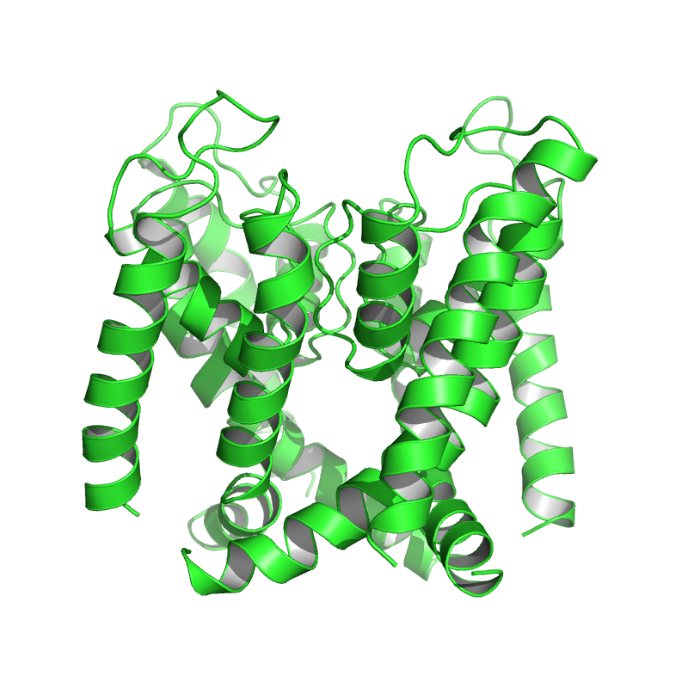
The hERG potassium channel
The hERG channel is important for conducting K⁺ ions out of heart muscle cells to return to the resting state.
Its correct function is critical for the correct duration of the action potential
Blockage of the channel by drugs is causing the ”aquired long QT-syndrome” which creates an increased risk of sudden cardiac death.
Model of the hERG channel

Slide 19
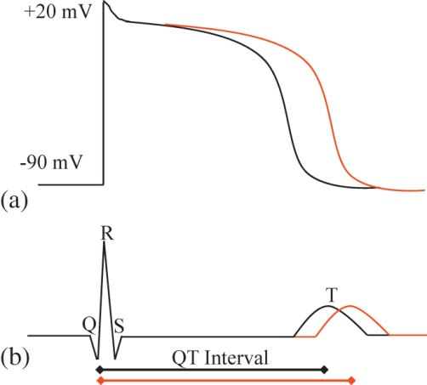
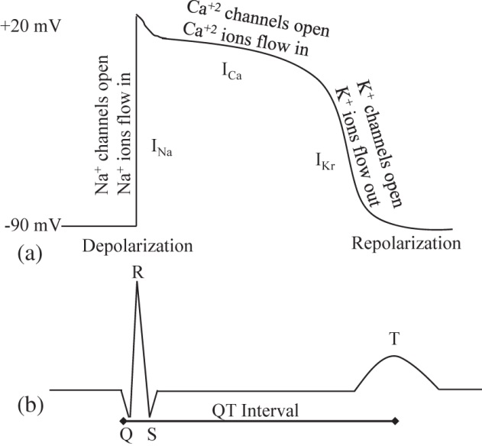
Cardiac Action Potential
Figure 8.16
Figure 8.17

Slide 20
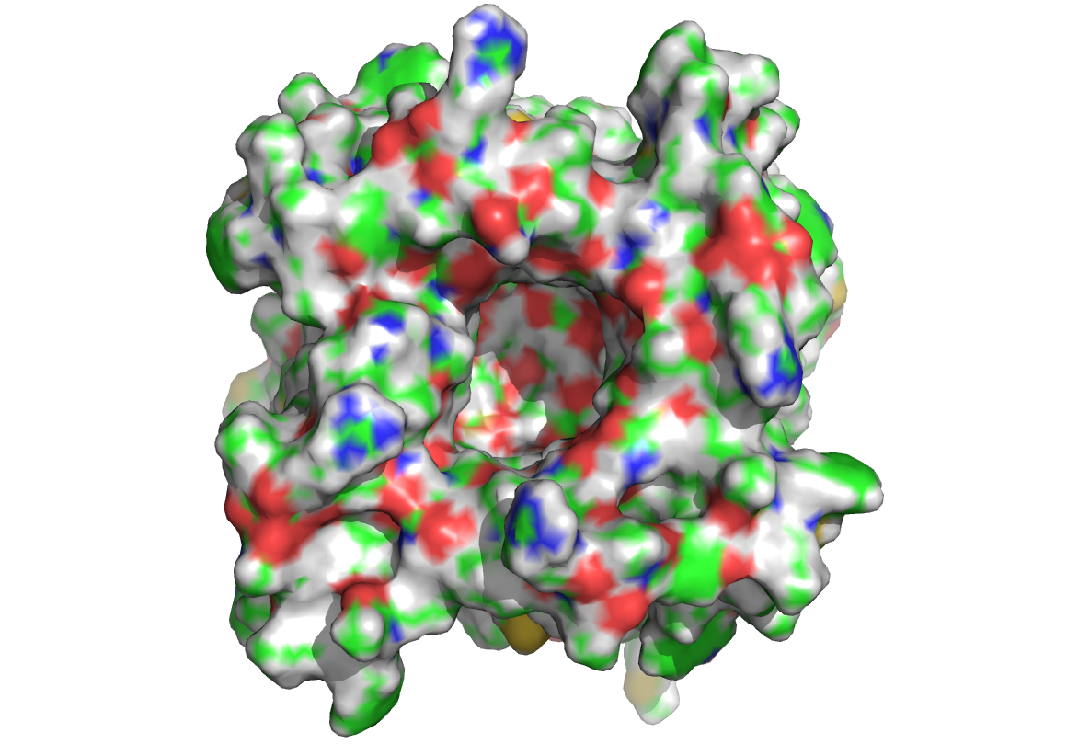
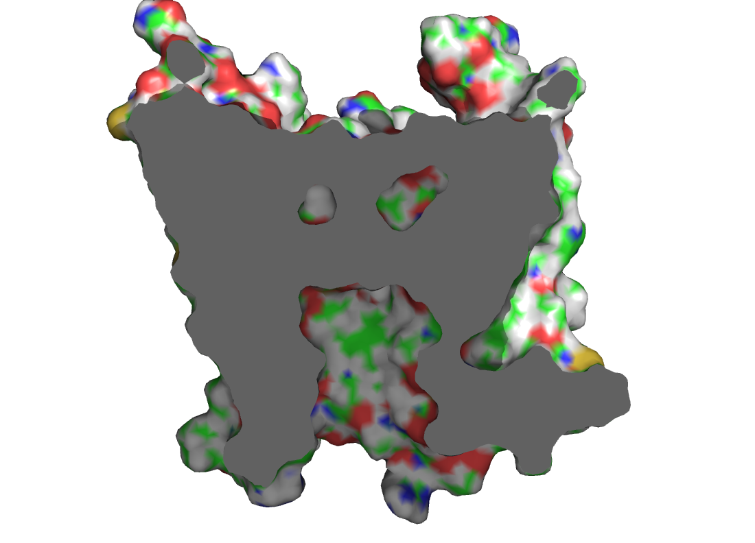
View from intracellular site
Large vestibule

Slide 21
Many drugs had to be removed from the market due to interaction with the hERG channel.
Astemizole, anti-histamine
Terfenadine, anti-histamine

Slide 22
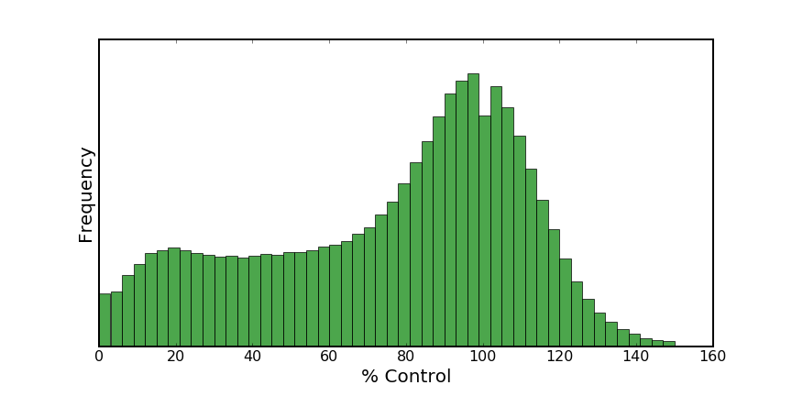
Many organic molecules interact with the hERG channel and other voltage-gated ion channels
Aryl
basic nitrogen
Aryl
Screening result on a voltage-gate calcium channel
The most potent channel blockers are compounds which have two aryl moieties and a central basic nitrogen
Assessment of hERG blockage is a standard task in modern drug discovery and done for every compound which becomes of interest in a drug discovery program.

Slide 23
CYP Inhibition
The cytochrome P450 enzymes are the primary metabolizing enzymes for most drugs.
Hepatic clearance and thus plasma levels and half-life are dependent on CYP metabolism
Inhibition of CYP enzymes can therefore have fatal consequences on the plasma levels of other substances, in particular other drugs. This phenomenon is called drug-drug interaction.

Slide 24
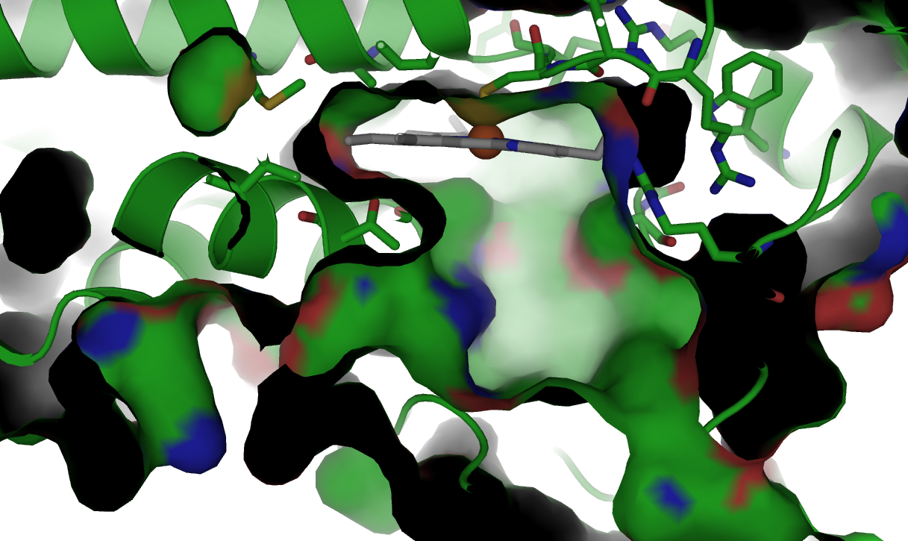
CYP enzymes contain a heme group with a central Fe-atom which is essential for catalytic function.

Slide 25
Fe forms tight complexes with many Lewis bases
In CYP enzymes 4 coordination partners are formed by the porphyrine ring, the 5th is usually a deprotonated cysteine or a histidine sidechain from the protein. The remaining 6th position is free and binds oxygen during the catalytic cycle.
Many organic molecules which contain a Lewis base are strong inhibitors of CYP enzymes
Clotrimazole, antifungal
Clarithromycin, antibiotic
Grapefruit
Fluconazole, antifungal

Slide 26
The anti-histamine Terfenadine has been a successful drug for years
Several patients died from sudden cardiac death when they, while on Terfenadine, consumed grapefruit juice or were in parallel treated with antibiotics.
So what did happen?

Slide 27
When Terfenadine is administered orally it is rapidly metabolized by CYP enzymes
CYP
hERG-Inhibitor
No hERG inhibition
Both, Terfenadine and its metabolite have anti-histamine activity
Terfenadine, however, is also a strong hERG blocker whereas its metabolite is not

Slide 28
Under normal conditions, the plasma concentration of Terfenadine is very low due to rapid metabolism
If this metabolic pathway is blocked or slowed down by CYP inhibiting drugs the plasma concentration of Terfenadine rises, leading to hERG blockage and thus an increased risk of sudden cardiac death.
CYP
hERG-Inhibitor
No hERG inhibition
Terfenadine has eventually replaced by its metabolite (Fexofenadin) since it offered the same benefit for the treatment of allergic reactions while offering improved safety.

Slide 29
Another example of metabolism-related toxicity
MPPP is an opioid analgesic and a close homolog of Meperidin, also a strong pain medication acting via opiod receptors.
Desmethylprodin (MPPP)
Opiod analgesic

Slide 30
Synthesis of MPPP comes along with a side-product, MPTP, which comes from beta-elimination of the intermediate tertiary alcohol under acidic conditions.
H⁺
-H₂O
MPTP
MPPP

Slide 31
MPTP has excellent brain permeation. Once in the brain it is metabolized by the enzyme MAO-B (monoamine oxydase) to MPP+
MAO-B
MPTP
MPP+ again has a high affinity for the dopamine transporter which leads to its rapid uptake in the dopaminergic neurons, primarily in the substantia nigra.
Inside cells MPP+ is highly toxic and leads to cell death.
The death of dopaminergic neurons in the substantia nigra leads to the same symptoms (severe motor disorders) as Parkinsons disease.

Slide 32
Mutagenic and Carcinogenic Toxicity
Drug candidates or their metabolites may also have the potential to promote the occurrence of mutations in the DNA of living organisms, which is an indicator for its carcinogenic potential.
The standard test to assess the mutagenic potential of drug candidates is the AMES test.

Slide 33
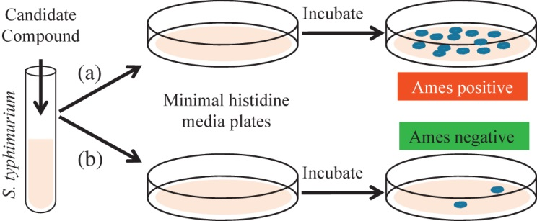
For the Ames test, a bacterial strain is used which has no ability to synthesize histidine, so it is dependent on the presence of histidine in the medium.
If the concentration of histidine in the medium is low, bacteria will grow very slowly
If the bacteria, incubated with the drug candidate recover their ability to synthesize histidine on their own, this indicates that the mutation rate in the bacteria is increased due to the presence of the drug.
Figure 8.10

Slide 34
Time for questions

Slide 35
What are the driving forces that govern protein folding of globular proteins?
Why is it difficult to develop selective inhibitors for kinases?
The compound below most likely has poor metabolic stability. Propose two modifications from which you would expect improved stability.

Slide 36
If a compound inhibits members of the Cytochrome P450 family, why is this potentially dangerous?
Explain the basic idea behind a DNA-encoded library. What is the advantage over a conventional screening pool?
What is the difference between a functional assay and a binding assay?

